Slide 1
Multithreading &
Parallelization
HackNEHS • Miles McCain

Slide 2
Let’s download a movie 30m
...put a pie in the oven 45m
...and walk the dog 20m

Slide 3
Without parallelization
download movie
bake
pie
walk dog

Slide 4
motivating-example-single.py

Slide 5
How long?
1 hour &
35 minutes.

Slide 6
With parallelization
download movie
bake
pie
walk dog

Slide 7
How long?
45 minutes.

Slide 8
motivating-example-multi.py

Slide 9
GIPHY/OCTONATION .

Slide 10
You now understand
parallelization.

Slide 11
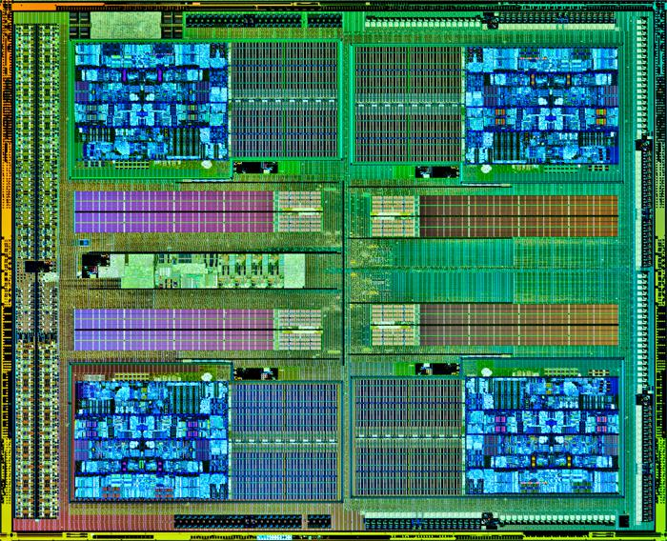
AMD FX 8350 .

Slide 12
concurrency is not
parallelization is not
multithreading

Slide 13
Parallelization
Concurrency
Multithreading
thread.spawn(background_process)

Slide 14
When to multithread?
You’re doing the same thing many times
You have lots of independent tasks
You need the illusion of speed

Slide 15
Who multithreads?
Web servers responding to requests
User interfaces performing network action
Background processes (e.g. encoding) in a video editor

Slide 16
How to multithread?
Just spawn a new thread!

Slide 17
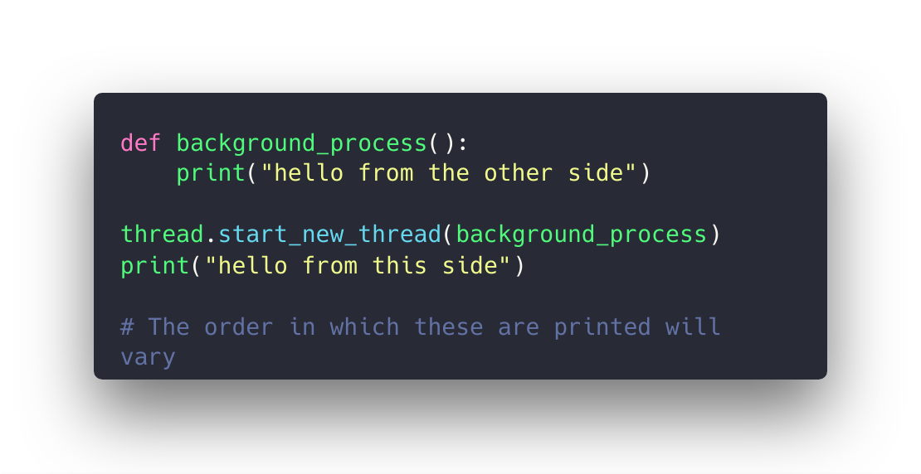

Slide 18
Multithreading is easy, communication is hard.

Slide 19
GIPHY/ALASTAIR GRAY .

Slide 20
GIPHY/CROSSFIT INC .

Slide 21
Beware of
deadlocks, race conditions, and unnecessary complexity.

Slide 22
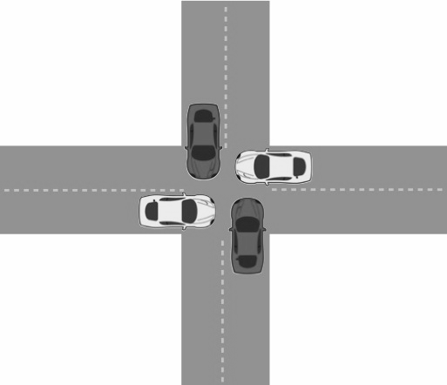
The ‘4 cars’ deadlock problem
Via Carnegie Mellon University, http://15418.courses.cs.cmu.edu/spring2013/article/27

Slide 23
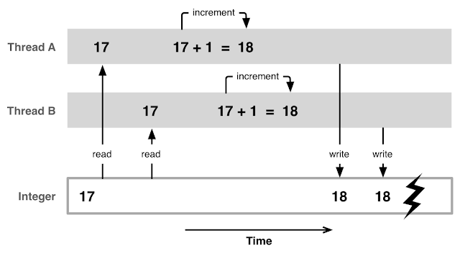
A classic ‘incremental’ race condition
Via Open Source for Geeks, http://opensourceforgeeks.blogspot.com/2014/01/race-condition-synchronization-atomic.html

Slide 24
fn scan_batch(&self, documents: &CompiledDocumentBatch) -> OutputBatch {
let mut output_batch = OutputBatch::from(vec![]);
for document in &documents.documents {
output_batch.merge_with(self.scan_single(document));
}
output_batch
}

Slide 25


Slide 26
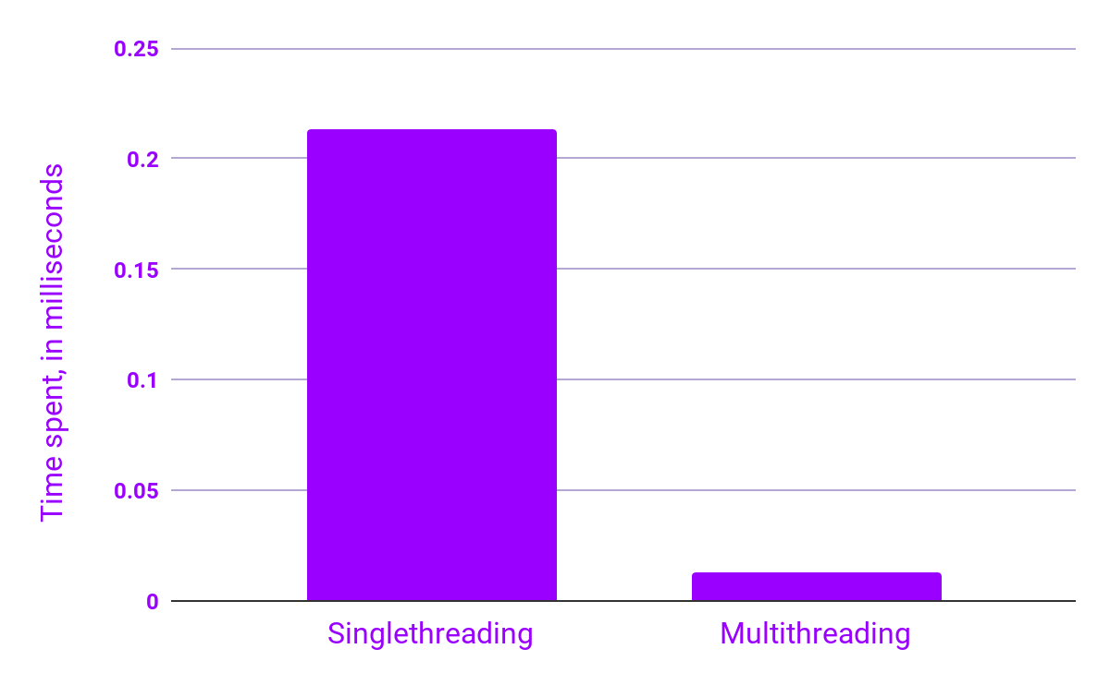
Time spent by IEQL per scanned document

Slide 27
When multithreading breaks,
it seriously breaks.
But when multithreading works,
it seriously works.

